Slide 1
HemTools Tutorial

Slide 2
Outline
Software overview
General principles
Examples
ATAC-seq
ChIP-seq
CUT & RUN
CRISPR-seq

Slide 3
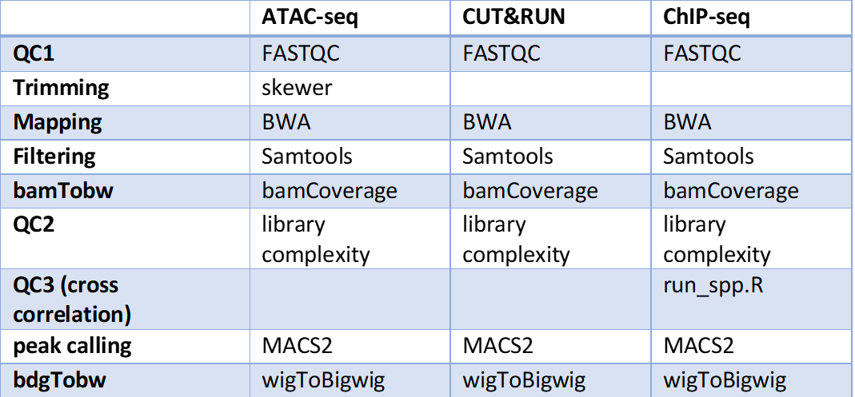
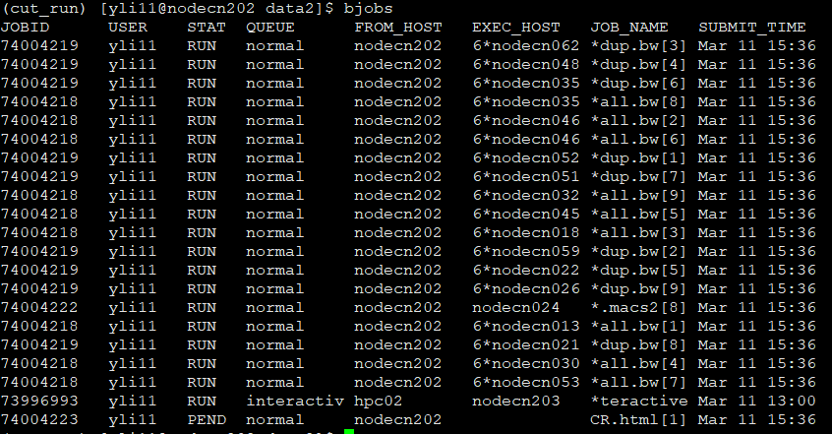
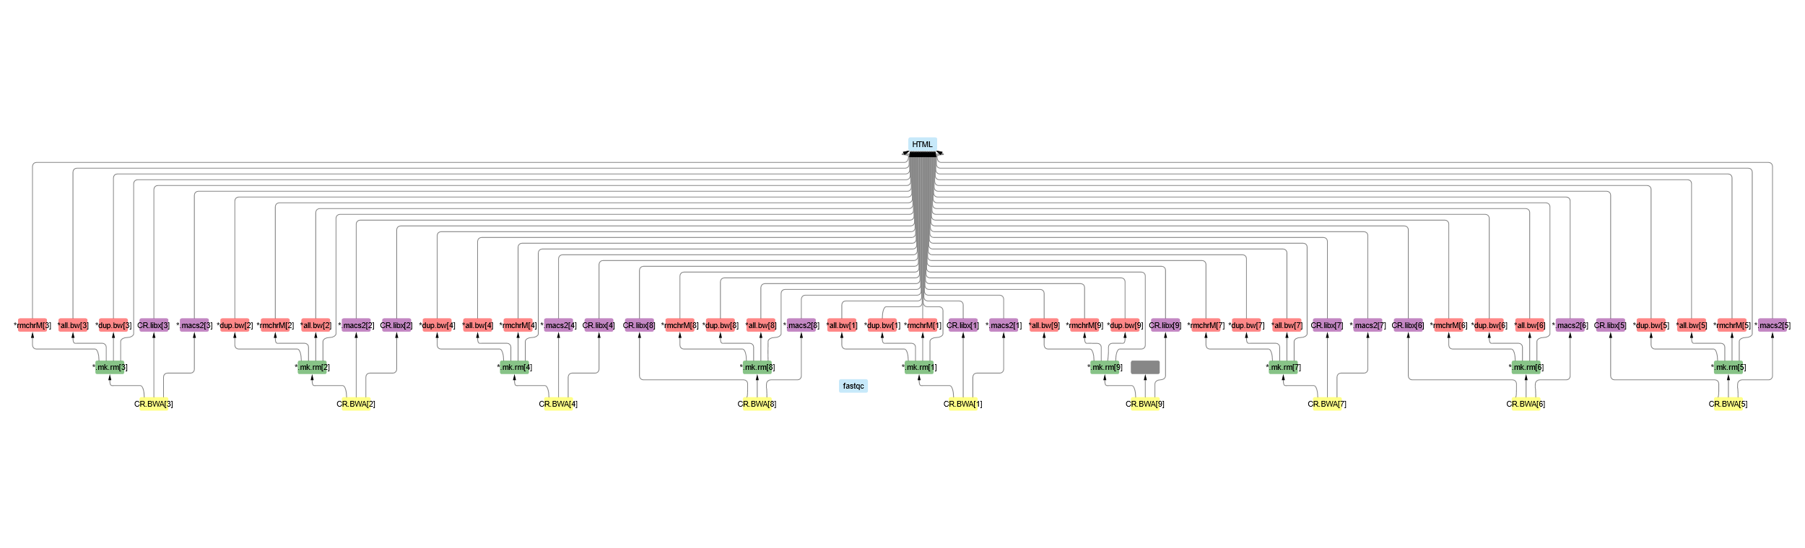
Software overview
Minimizing computation time
A tree of jobs

Slide 4
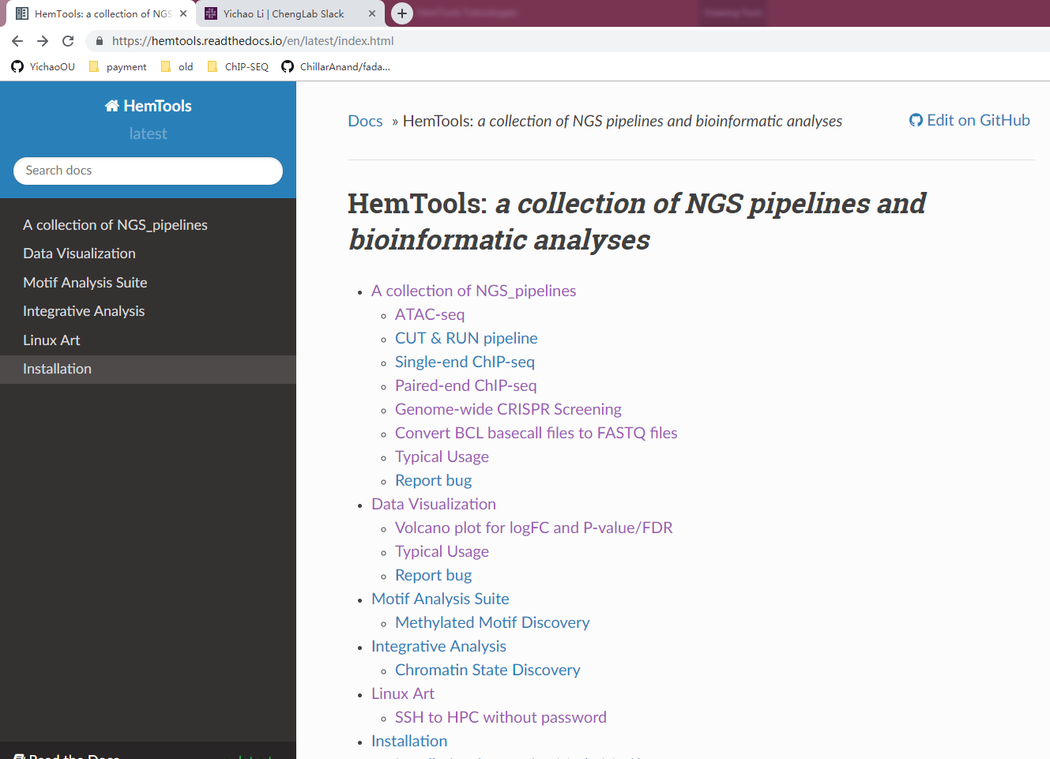
Software overview
Minimizing computation time
A tree of sub-jobs
Creating user-friendly interface
Online documentation
https://hemtools.readthedocs.io

Slide 5
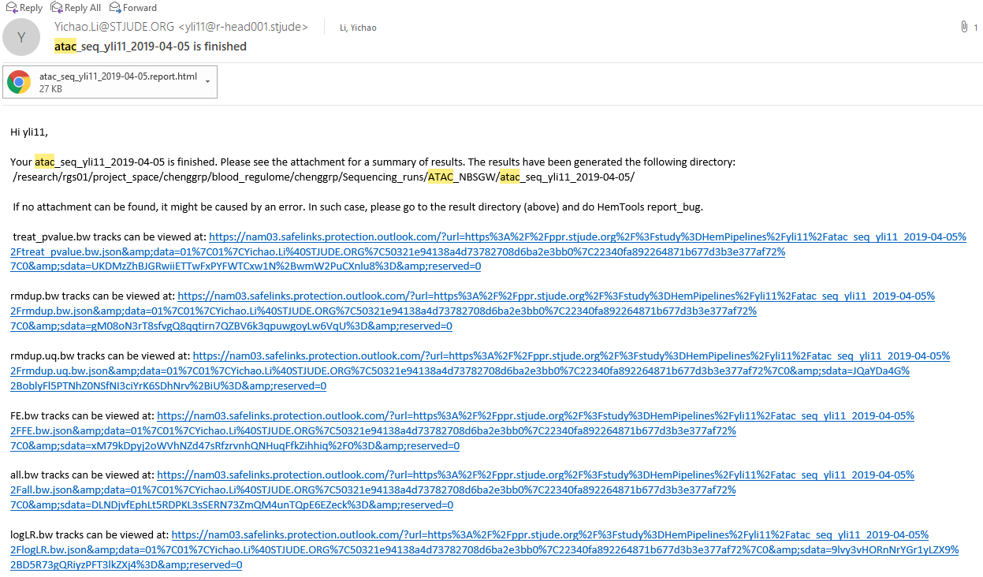
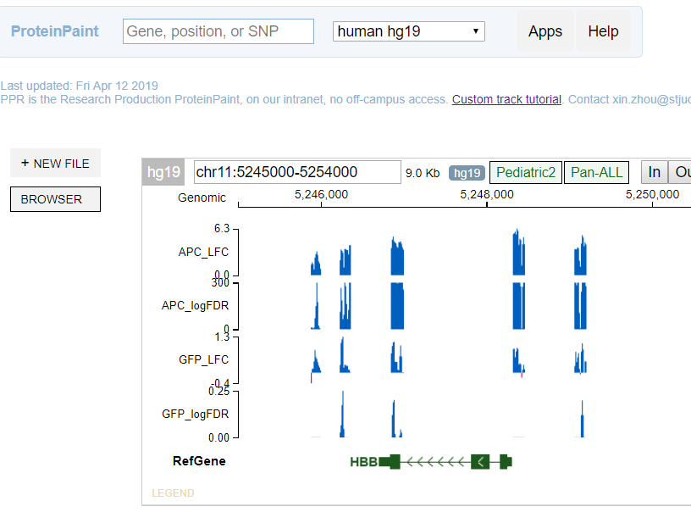
Software overview
Minimizing computation time
A tree of sub-jobs
Creating user-friendly interface
Online documentation
https://hemtools.readthedocs.io
Email notification system

Slide 6
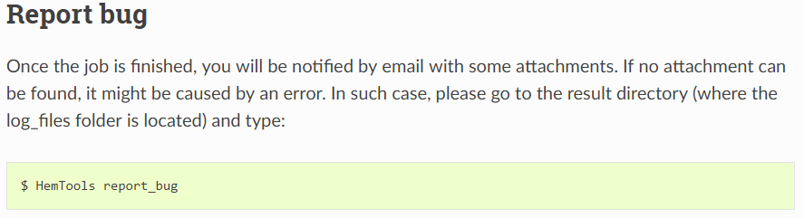
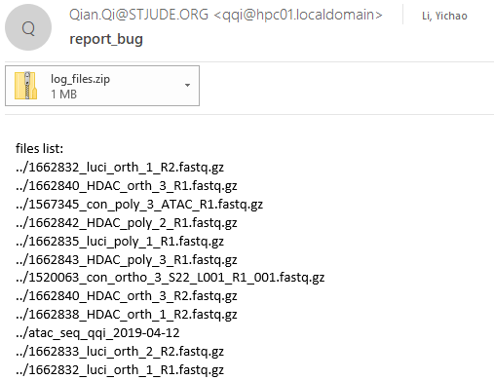
Software overview
Minimizing computation time
A tree of sub-jobs
Creating user-friendly interface
Online documentation
https://hemtools.readthedocs.io
Email notification system
Bug/Error notification system

Slide 7
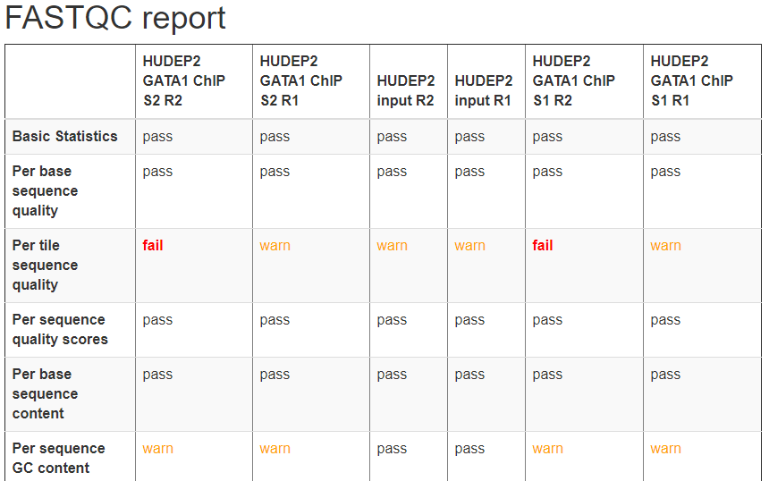
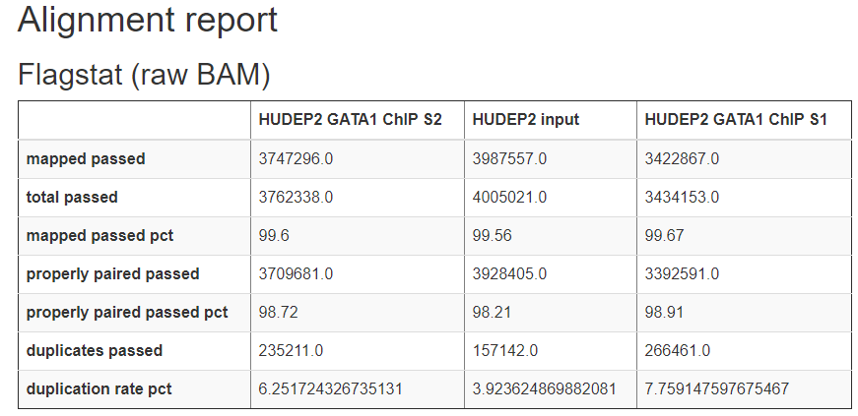
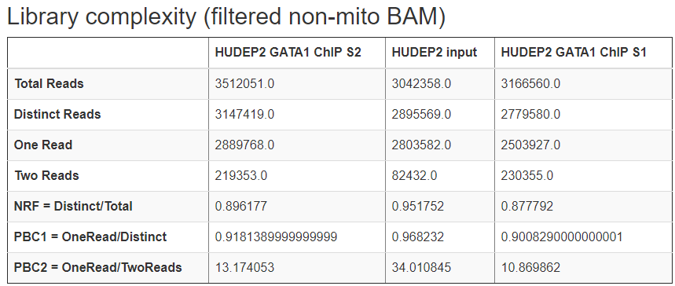
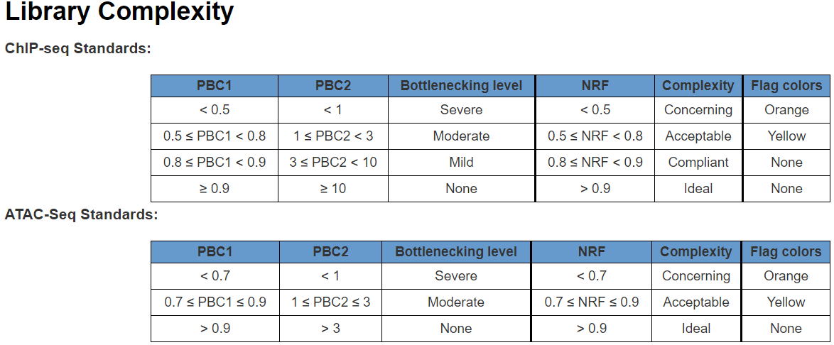
Software overview
Minimizing computation time
A tree of sub-jobs
Creating user-friendly interface
Online documentation
https://hemtools.readthedocs.io
Email notification system
Bug/Error notification system
Visually-appealing reports
https://www.encodeproject.org/data-standards/terms/#library

Slide 8
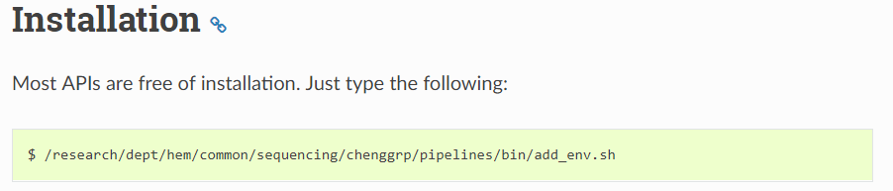
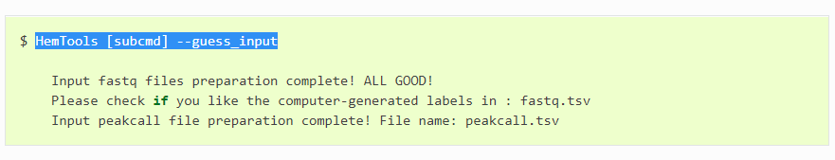
Software overview
Minimizing computation time
A tree of sub-jobs
Creating user-friendly interface
Online documentation
https://hemtools.readthedocs.io
Email notification system
Bug/Error notification system
Visually-appealing reports
Reducing user’s mental effort
Free of installation
Simple input files preparation

Slide 9
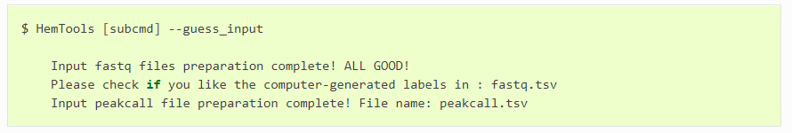
General principles
Workflow
Load Python
Prepare Inputs
Run HemTools

Slide 10
General principles
Command format
HemTools subcmd some_required_parameters
HemTools atac_seq -f fastq.tsv
HemTools cut_run -f fastq.tsv -d peakcall.tsv
HemTools chip_sEQ_Single -f fastq.tsv -d peakcall.tsv
HemTools chip_seq_pair -f fastq.tsv -d peakcall.tsv
SuBcMd is case-insensitive

Slide 11
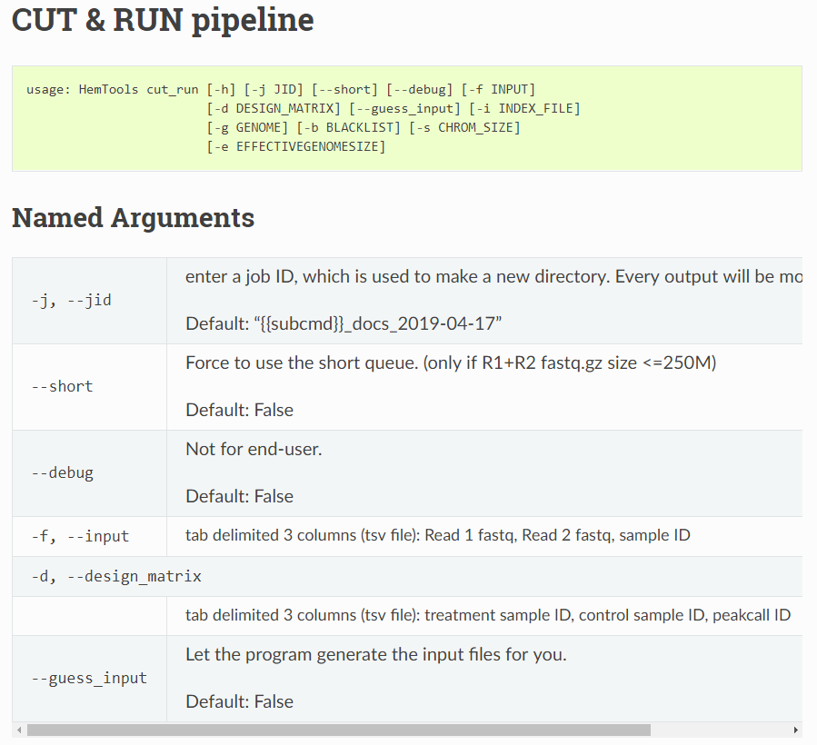
General principles
Required parameters
HemTools atac_seq -f fastq.tsv
HemTools cut_run -f fastq.tsv -d peakcall.tsv
HemTools chip_seq_single -f fastq.tsv -d peakcall.tsv
HemTools chip_seq_pair -f fastq.tsv -d peakcall.tsv

Slide 12
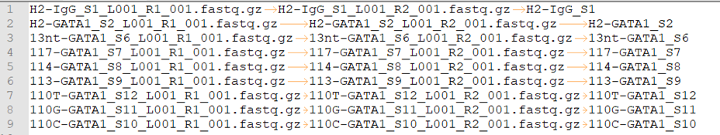
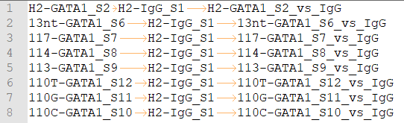
General principles
Command format
HemTools atac_seq -f fastq.tsv
HemTools cut_run -f fastq.tsv -d peakcall.tsv
HemTools chip_seq_single -f fastq.tsv -d peakcall.tsv
HemTools chip_seq_pair -f fastq.tsv -d peakcall.tsv
Input format (tsv, tab-separated values)
-f, --input
-d, --design_matrix

Slide 13
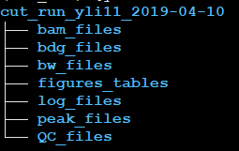
General principles
Output format

Slide 14
General principles
Report bugs

Slide 15
CUT & RUN example

Slide 16
Materials
Handouts
Questionnaire
Online doc
Terminal
Ppt

Slide 17
Software requirements analysis
Adapting and automating previous pipelines
Minimizing computation time
Creating user-friendly interface
Online end-user documentation
Email notification system
Bug/Error notification system
Visually-appealing reports
Reducing user’s mental effort
Free of installation & ready to use
Simple input files preparation
Easy search for appropriate APIs

Slide 18
Linux 101

